Slide 1
Does syntax matter? A strong baseline for Aspect-based Sentiment Analysis with RoBERTa
Junqi Dai, Hang Yan,
Tianxiang Sun, Pengfei Liu, Xipeng Qiu

Slide 2
Contents
Introduction
Methods
Experiments
Analysis

Slide 3
Contents
Introduction
Methods
Experiments
Analysis

Slide 4
Aspect-Based Sentiment Analysis
Aspect-Based Sentiment Analysis (ABSA) consists of two subtasks: Aspect Extraction (AE) and Aspect-Level Sentiment Classification (ALSC)
Great food but the service was dreadful

Slide 5
Aspect-Based Sentiment Analysis
Aspect-Based Sentiment Analysis (ABSA) consists of two subtasks: Aspect Extraction (AE) and Aspect-Level Sentiment Classification (ALSC)
Great food but the service was dreadful

Slide 6
Aspect-Based Sentiment Analysis
Aspect-Based Sentiment Analysis (ABSA) consists of two subtasks: Aspect Extraction (AE) and Aspect-Level Sentiment Classification (ALSC)
Great food but the service was dreadful
Positive Negative

Slide 7
Dependency tree
Capture syntactic features from a sentence
Help the aspects find their contextual words
Great food but the service was dreadful

Slide 8
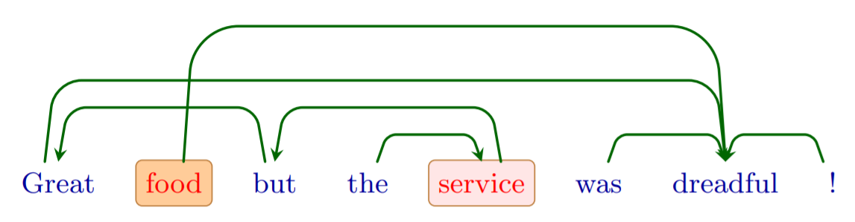
Dependency tree
Capture syntactic features from a sentence

Slide 9
Dependency tree
Question: What else can capture syntactic features?

Slide 10
Dependency tree
Question: What else can capture syntactic features?
Answer: Pre-trained Models (Perturbed Masking → Tree)
Help the aspects find their contextual words
Great food but the service was dreadful

Slide 11
Two questions
Q1: Will the tree induced from pre-trained models achieve better performance than the tree given by a dependency parser when combined with different tree-based ALSC models?
Q2: Will pre-trained models adapt the implicitly entailed tree structure to the ALSC task during the finetuning?

Slide 12
Contents
Introduction
Methods
Experiments
Analysis

Slide 13

Perturbed Masking
Sentence ${x=[x}_{1},…,x_{T}]$
BERT and RoBERTa will map each $x_{i}$ into contextualized representation $H_{θ}(x)_{i}$
Perturbed Masking derives the impact a token $x_{j}$ on another token $x_{i}$
$f\left(x_{i},x_{j}\right)={∥H_{θ}(x{\backslash \{x_{i}\})}_{i} −H_{θ}(x\backslash \{x_{i},x_{j}\})_{i}∥}_{2}$
Repeating this process between every two tokens and get an impact matrix $M_{i,j}=$ $f\left(x_{i},x_{j}\right)$

Slide 14
Heatmap of the impact matrix
“For those who follow social media transitions on Capitol Hill, this will be a little different.”

Slide 15
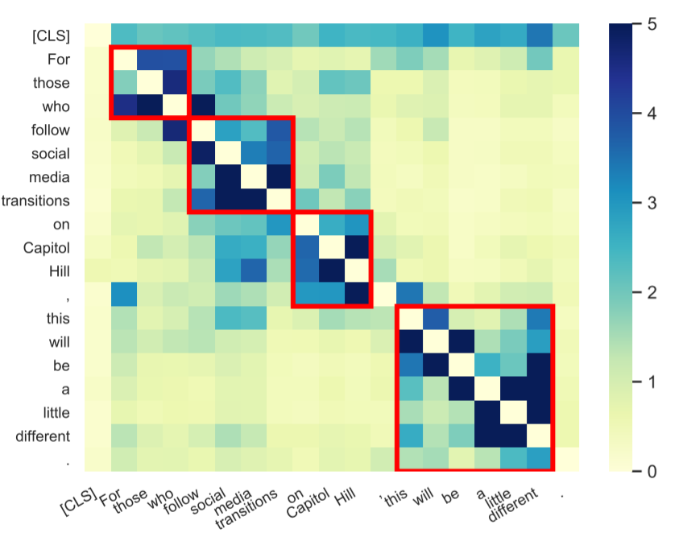
Heatmap of the impact matrix Masking
“For those who follow social media transitions on Capitol Hill, this will be a little different.”

Slide 16
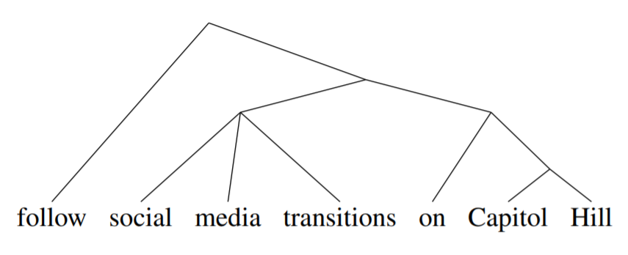
Tree generated by Stanford CoreNLP

Slide 18
Extract Tree
Jason M. Eisner. 1996. Three new probabilistic models for dependency parsing: An exploration.
Y. J. Chu and T. H. Liu. 1965. On the shortest arborescence of a directed graph.
Jack Edmonds. 1967. Optimum branchings.

Slide 19
Tree-based ALSC Models
Aspect-specific Graph Convolutional Networks (ASGCN)
Use Graph Convolutional Network to dependency tree
Proximity-Weighted Convolution Network (PWCN)
Proximity value: shortest path in the dependency tree between words and aspects
Relational Graph Attention Network (RGAT)
Transform the dependency tree into an aspect-oriented dependency tree
Aspect is the root node, and all other words depend on the aspect directly
Notes:
RGAT: syntactic tags

Slide 20
Tree structures
“Dep.”: off-the-shelf dependency tree parser (spaCy, allenNLP)
“Left-chain” and “Right-chain”: every word deems its previous or next word as the dependent child word
“BERT Induced Tree” and “RoBERTa Induced Tree”: trees induced from pre-trained BERT and RoBERTa by the Perturbed Masking
“FT-BERT Induced Tree” and “FT-RoBERTa Induced Tree”: trees induced from fine-tuned BERT and RoBERTa by the Perturbed Masking

Slide 21
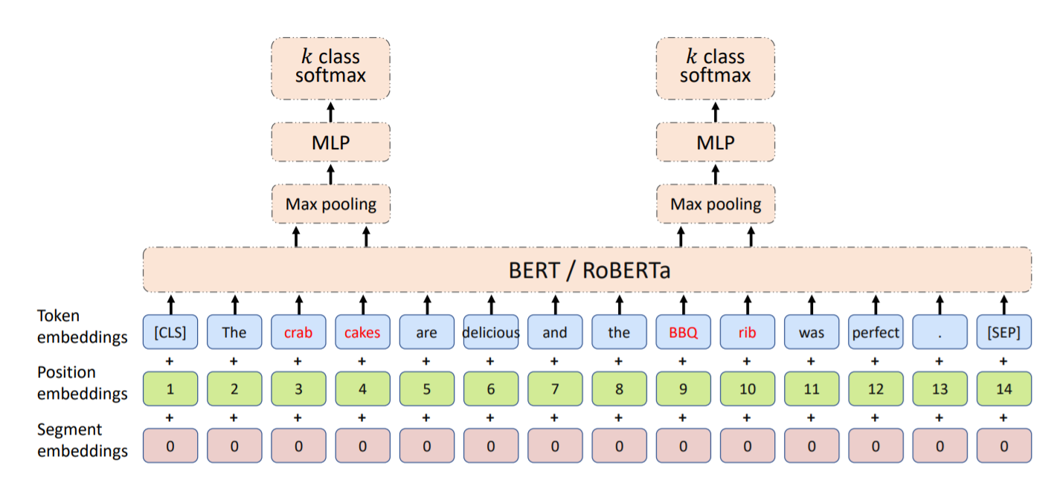

Slide 22
Contents
Introduction
Methods
Experiments
Analysis

Slide 23
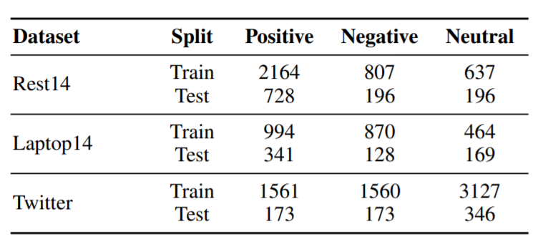
Datasets

Slide 24
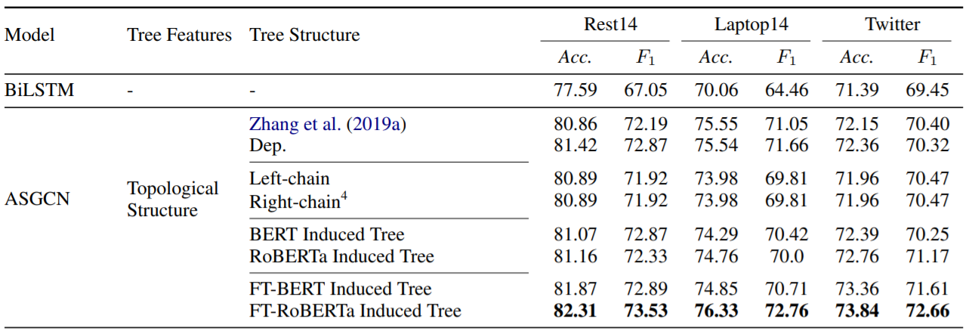
Experimental results
Notes:
Fixed Glove embeddings
FT-BERT and FT-RoBERTa Induced Tree is competitive
Small performance difference between bert, Roberta and left-right chain
Although models with the PTMs induced trees usually perform worse than those with the dependency parsing trees, models with trees induced from ALSC fine-tuned RoBERTa can surpass both of them.
Predictable since the word in PTMs induced trees tends to depend on words in their either left or right side as show

Slide 25
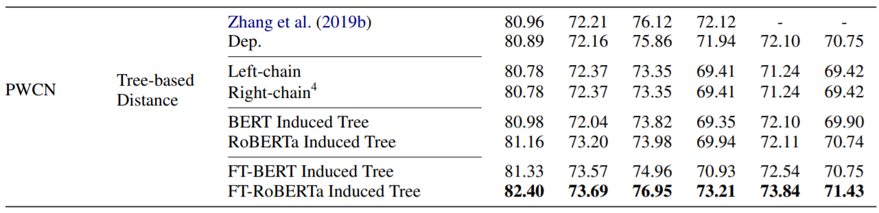
Experimental results
Notes:
Similar results

Slide 26
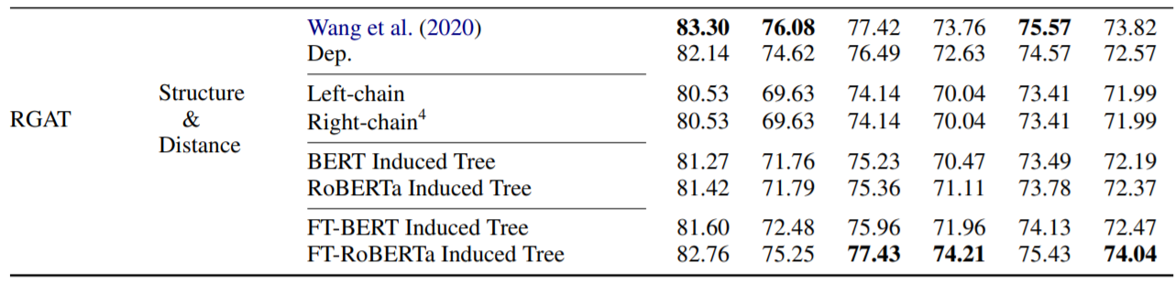
Experimental results
Notes:
the induced tree does not provide syntactic tags, we assign virtual tags for every dependency in a uniform way, which slightly damage the performance of model.

Slide 27
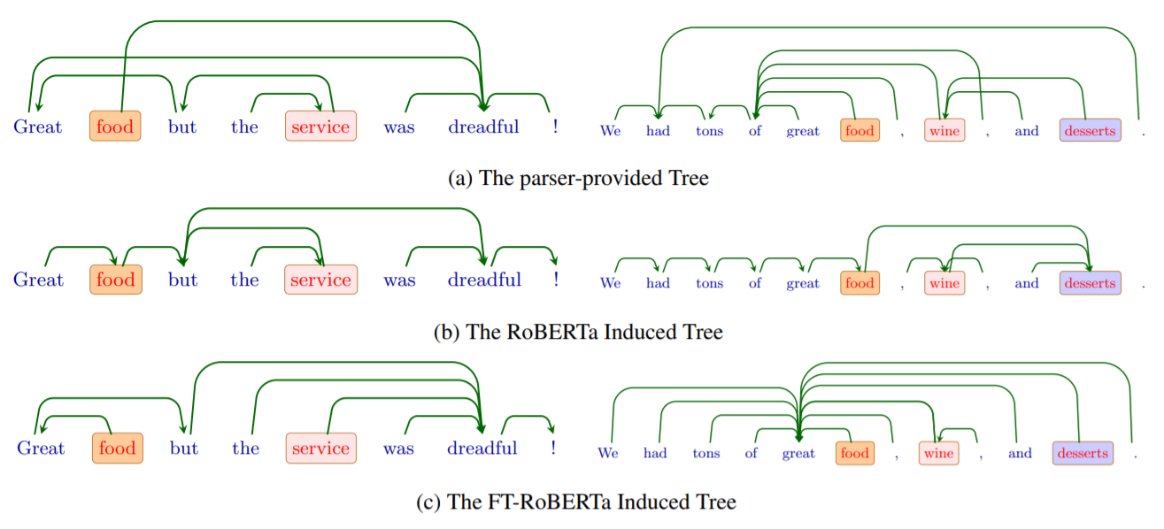
Visualization of different trees
Notes:
The results show that models with dependency trees usually achieve better performance than PTMs induced trees. the word in PTMs induced trees tends to depend on words in their either left or right side as show

Slide 28
Contents
Introduction
Features
Experiments
Analysis

Slide 29
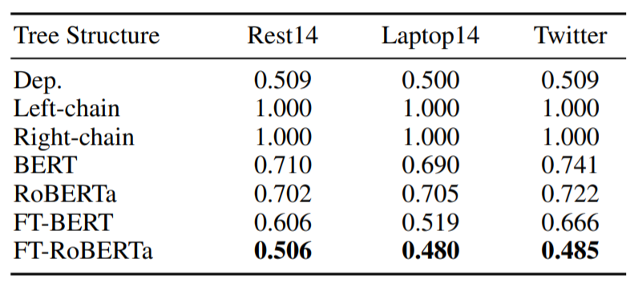
Proportion of neighboring connections
Notes:
we observe that on average over 70% relations in BERT/RoBERTa Induced Tree are neighboring connections. This will damage the performance of models using topological structures of trees. Thus, PTMs induced trees usually perform worse than “Dep.”， with a slight improvement over left/right-chains

Slide 30
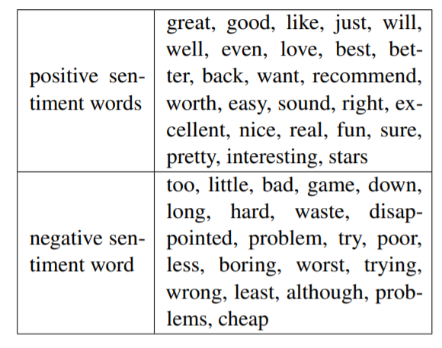

Aspects-sentiment Distance
Sentiment words set $C$
Notes:
selected 50 most frequent sentiment words counted

Slide 31
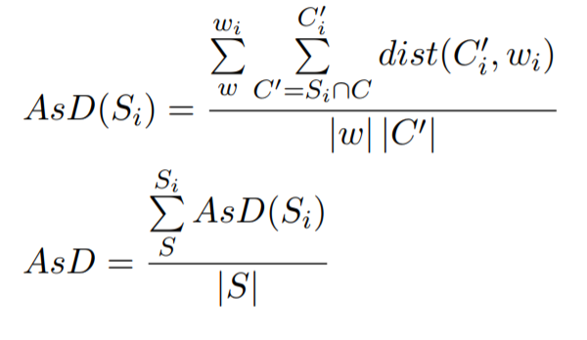
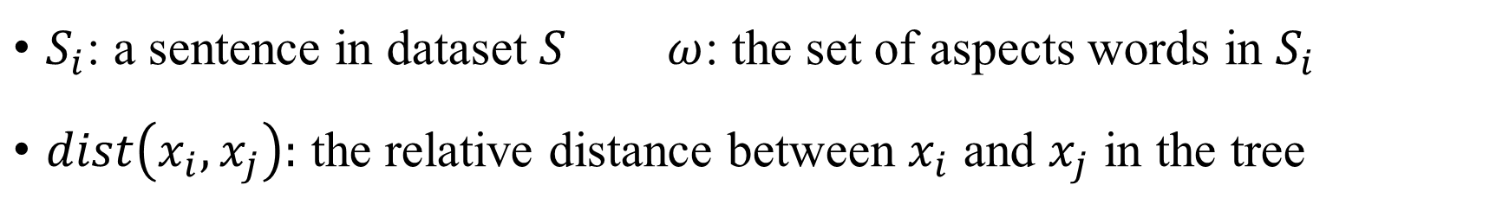
Aspects-sentiment Distance
$S_{i}$: a sentence in dataset $S ω$: the set of aspects words in $S_{i}$
$dist\left(x_{i},x_{j}\right):$ the relative distance between $x_{i}$ and $x_{j}$ in the tree

Slide 32
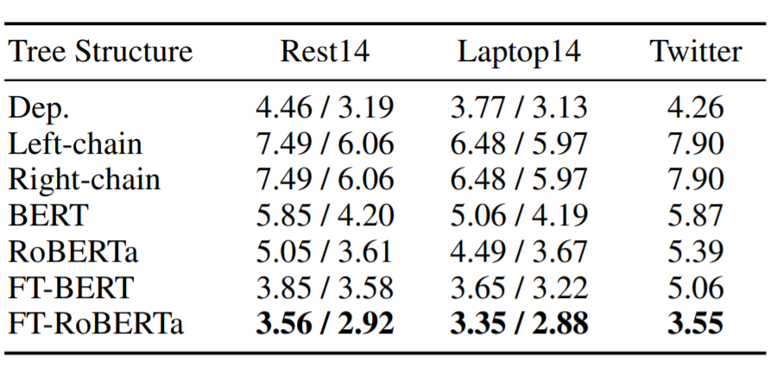
Aspects-sentiment Distance
Notes:
pAsD / AsD
paired Aspects-sentiment Distance(pAsD): only counts the distance between aspect and its corresponding sentiment words
FT-PTMs induced trees are more sentiment-word-oriented

Slide 33
Two questions
Q1: Will the tree induced from pre-trained models achieve better performance than the tree given by a dependency parser when combined with different tree-based ALSC models?
Q2: Will pre-trained models adapt the implicitly entailed tree structure to the ALSC task during the finetuning?
Notes:
Both yes

Slide 34
Comparison between SOTA ALSC models

Slide 35
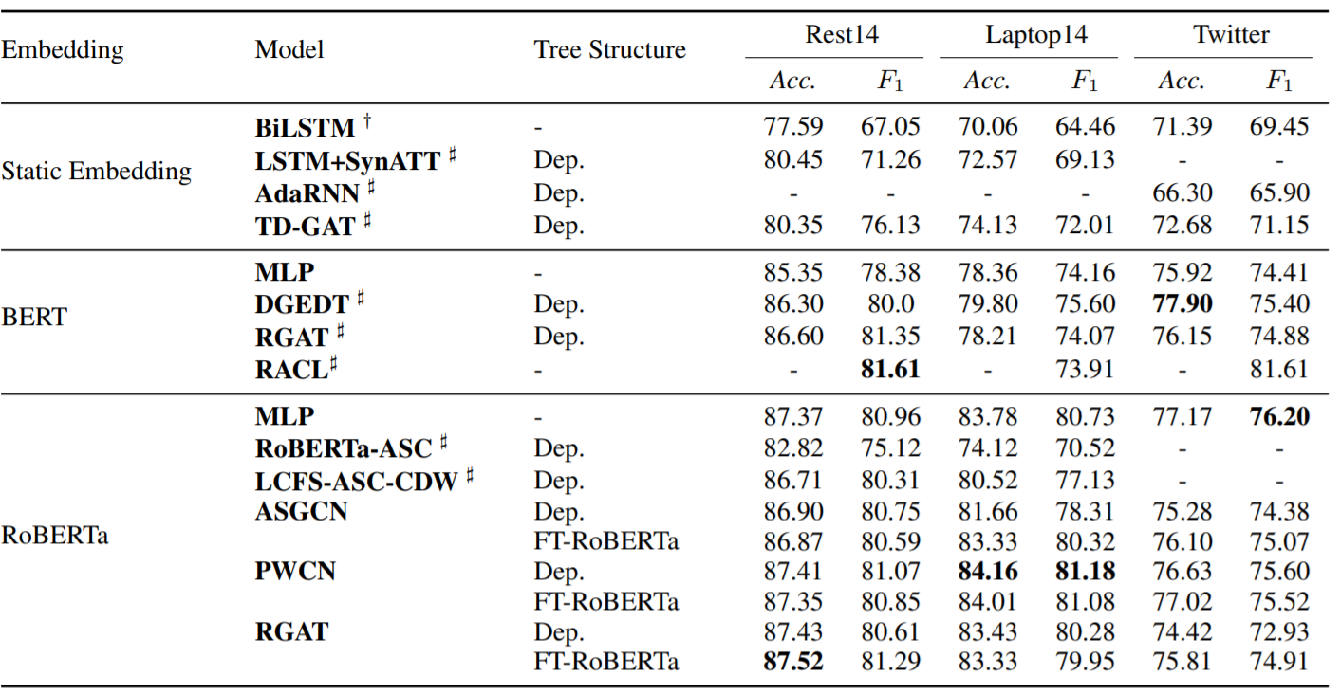
Comparison between ALSC models
Notes:
the RoBERTa with an MLP layer achieve SOTA or near SOTA performance
significant improvement is obtained on the Laptop14 dataset
limited improvements have been made over the RoBERTaMLP
The FT-RoBERTa Induced Tree could be beneficial to Glove based ALSC models. However, incorporating trees over the RoBERTa brings no significant improvement, even the decline can be seen in some cases.

Slide 36
Conclusions
Fine-tuning on ALSC task forces PTMs to implicitly learn more sentimentword-oriented trees, which can bring benefits to Glove based ALSC models
Benefited from its better implicit syntactic information, fine-tuned RoBERTa with an MLP is enough to obtain SOTA or near SOTA results for ALSC task

Slide 37
Q&A

